Slide 1
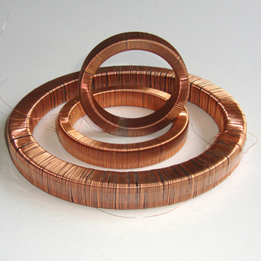
Section 7: Current and Resistance

Slide 2
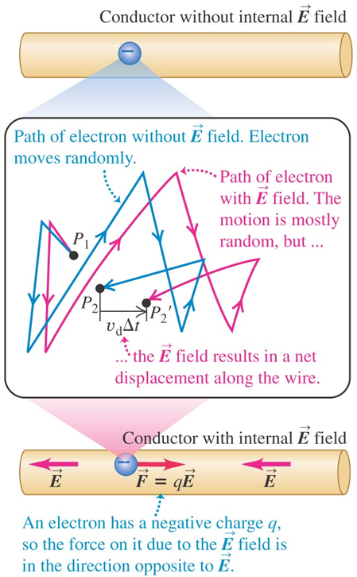
Conductors and Charge Flow

Slide 3
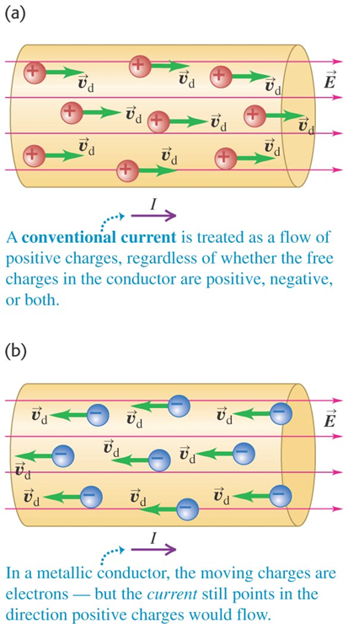
Direction of Charge Flow

Slide 4
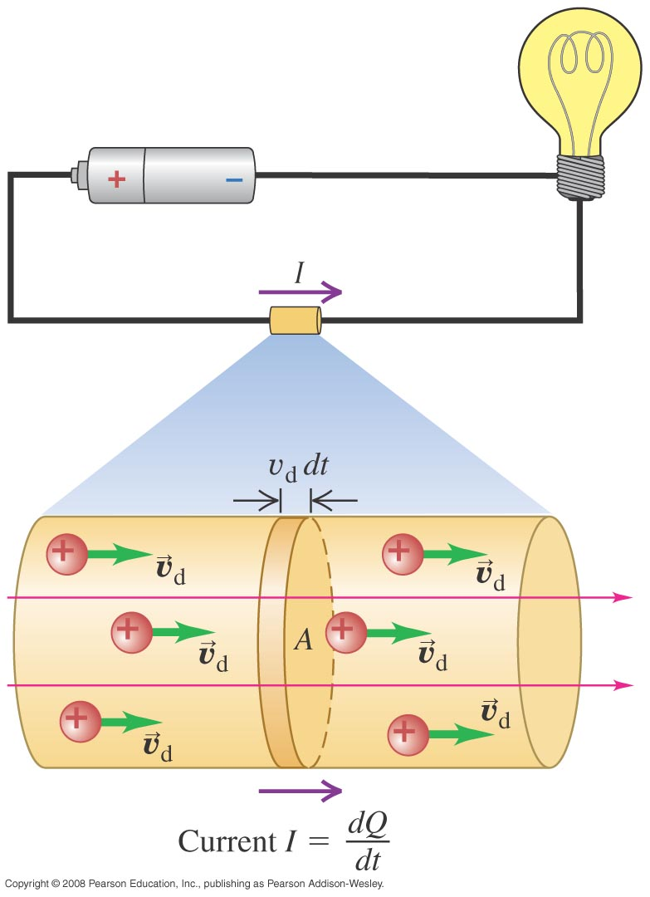
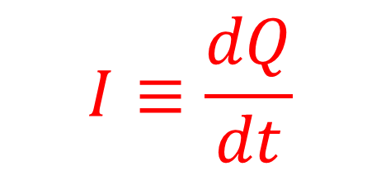
Definition of Current
$$I≡\frac{dQ}{dt}$$

Slide 5
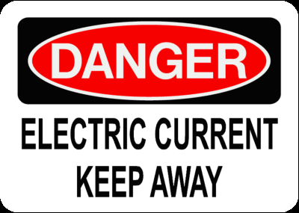
Current
Unit of current: Ampere (A)
1 A = 1 C/s

Slide 6


Calculating Current
$$I=nqAv_{d}$$

Slide 7
Example: Current and Drift Speed

Slide 8
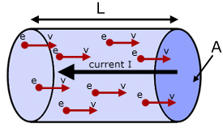

Current Density
$$J≡\frac{I}{A}$$
$$\vec{J}=nq{\vec{v}}_{d}$$

Slide 9

Resistivity
Resistance to charge flow:
$$ρ≡\frac{E}{J}$$
Conductivity is the reciprocal of resistivity: $σ≡\frac{1}{ρ}$

Slide 10
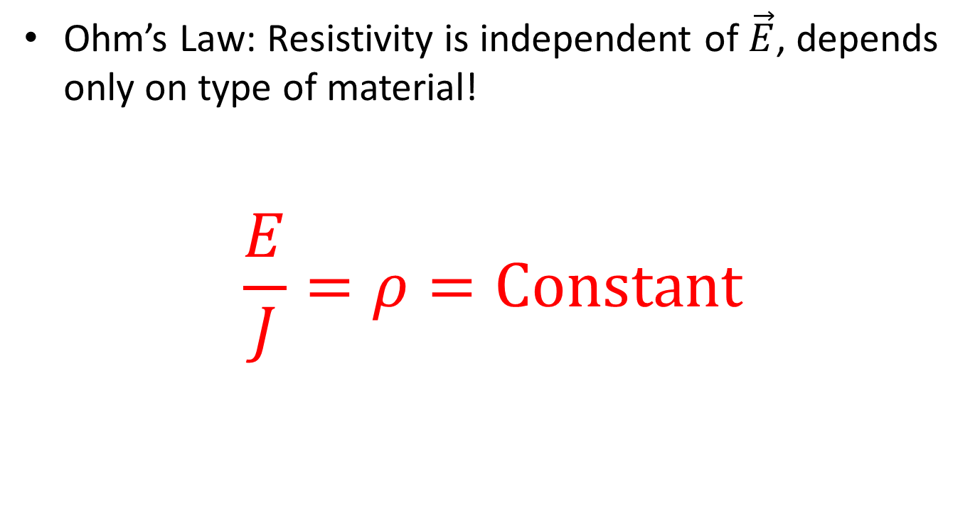
Ohm’s Law
Ohm’s Law: Resistivity is independent of $\vec{E}$, depends only on type of material!
$$\frac{E}{J}=ρ=\text{Constant}$$

Slide 11
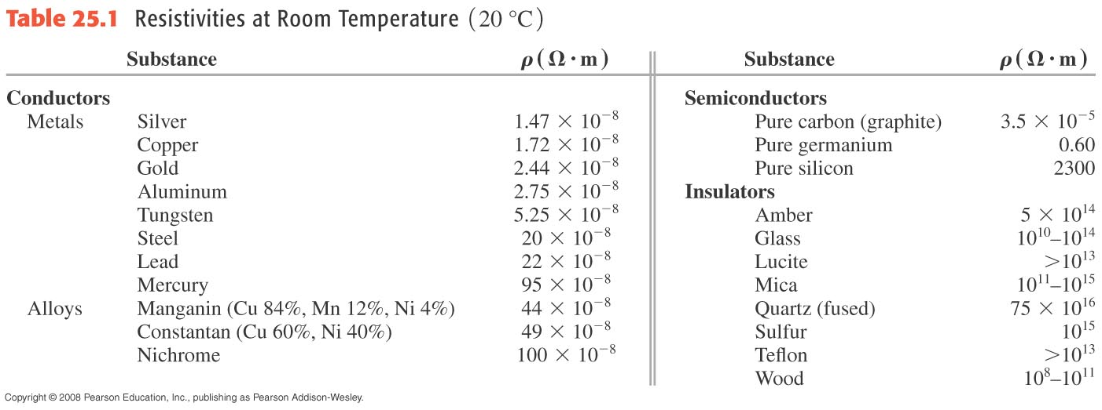
Resistivity is intrinsic to a sample (like density)

Slide 12
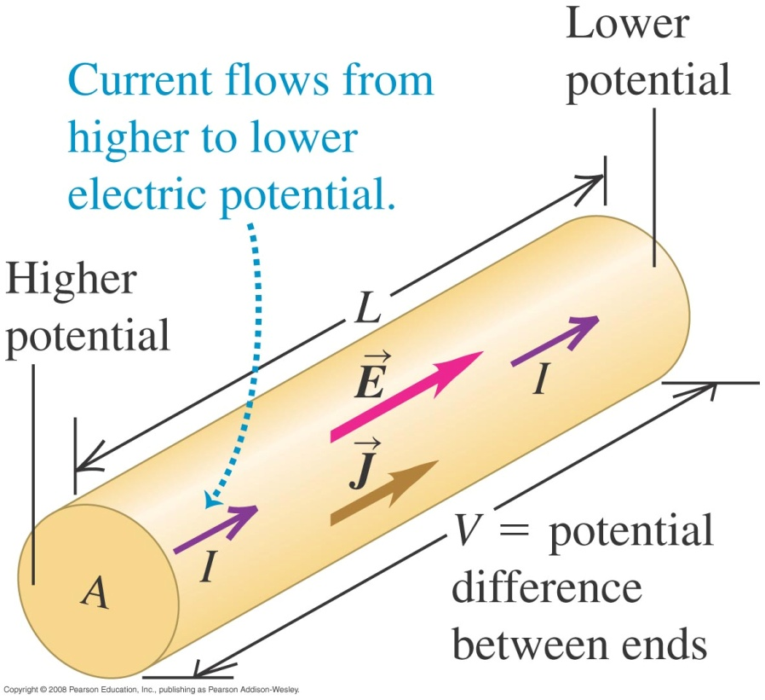

Ohm’s Law Rewritten
More useful version
$$V=IR$$

Slide 13
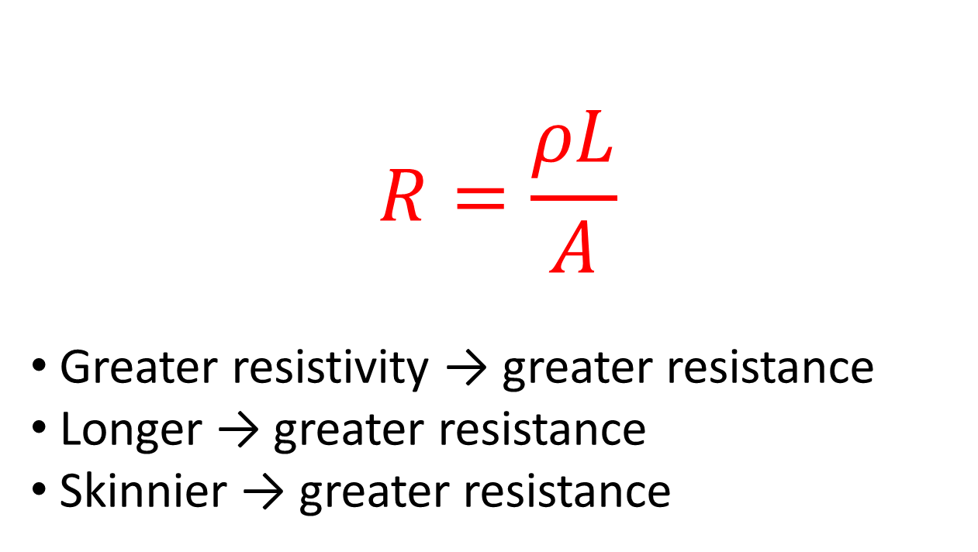
Resistance
$$R=\frac{ρL}{A}$$
Greater resistivity → greater resistance
Longer → greater resistance
Skinnier → greater resistance

Slide 14
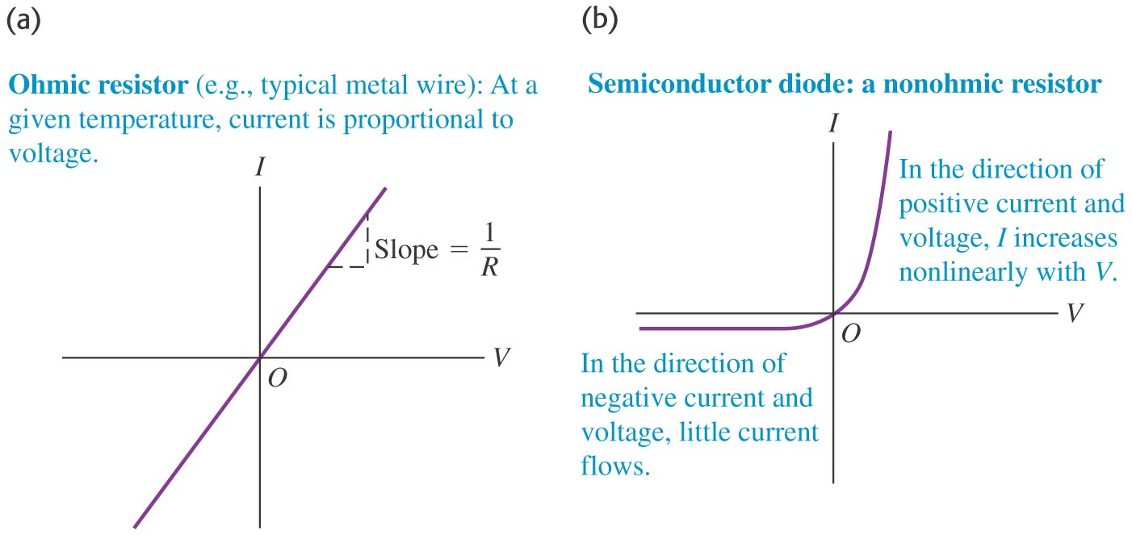
Current–voltage Relationships: Ohmic vs. Nonohmic Resistor

Slide 15
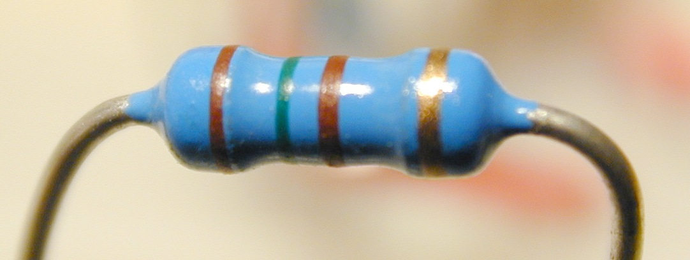
Resistance
Unit of Resistance: Ohm (Ω)
1 Ω = 1 V/A

Slide 16
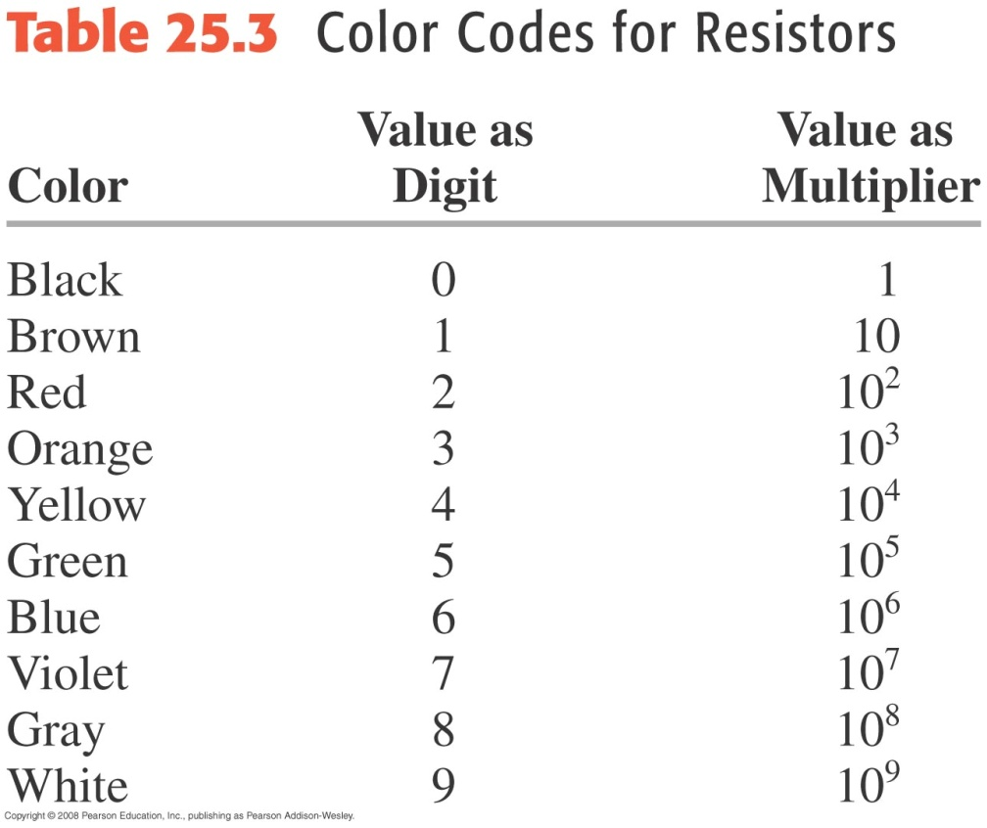
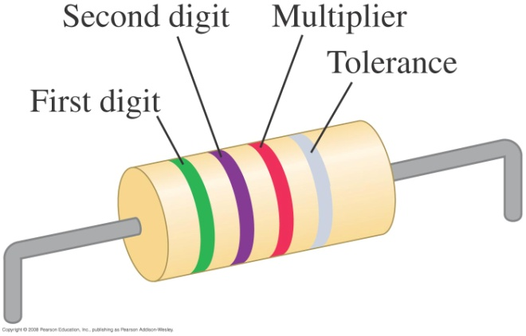
Resistors are color-coded for assembly work

Slide 17
Activity: Resistivity and Resistance

Slide 18
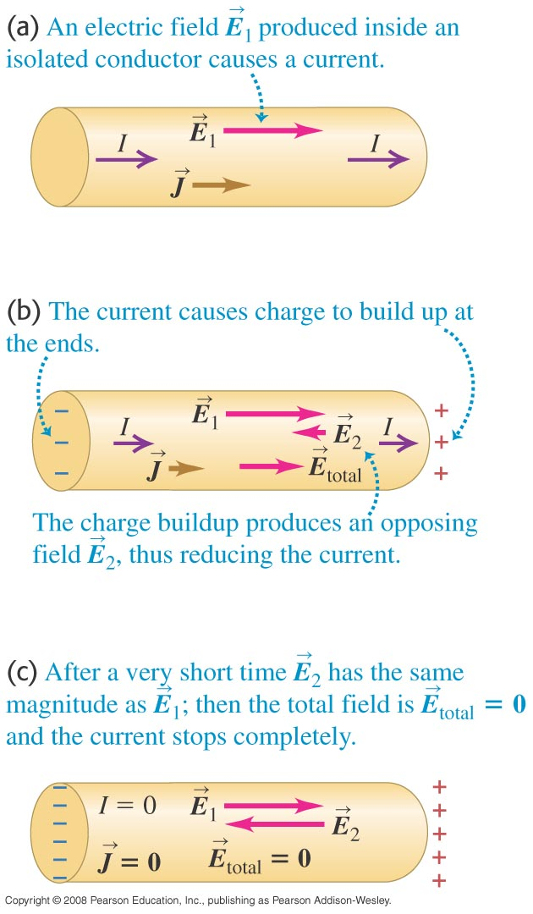
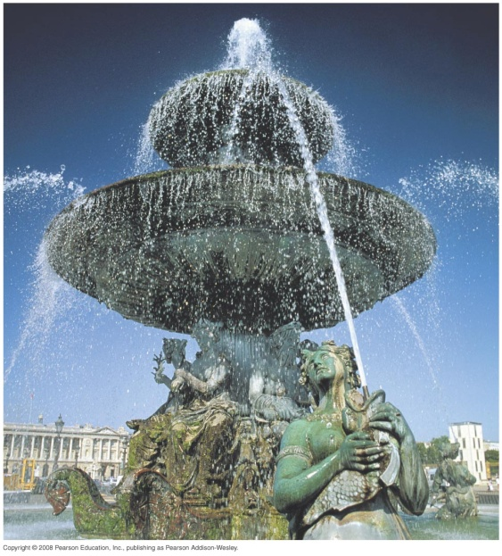
Electromotive Force and Circuits

Slide 19
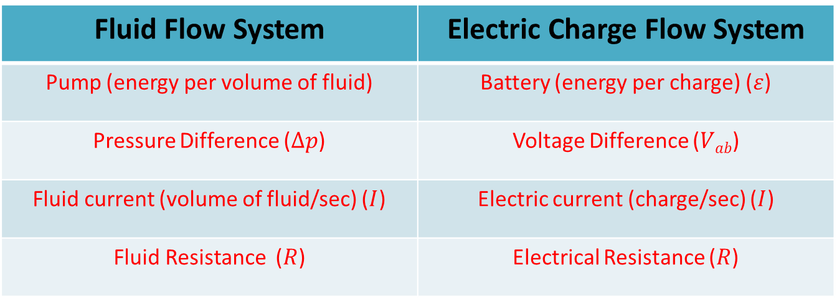
Fluid Circuit and Electric Circuit Analogies
Fluid Flow System | Electric Charge Flow System
Pump (energy per volume of fluid) | Battery (energy per charge) ($ε$)
Pressure Difference ($Δp$) | Voltage Difference ($Vab$)
Fluid current (volume of fluid/sec) ($I$) | Electric current (charge/sec) ($I$)
Fluid Resistance ($R$) | Electrical Resistance ($R$)

Slide 20
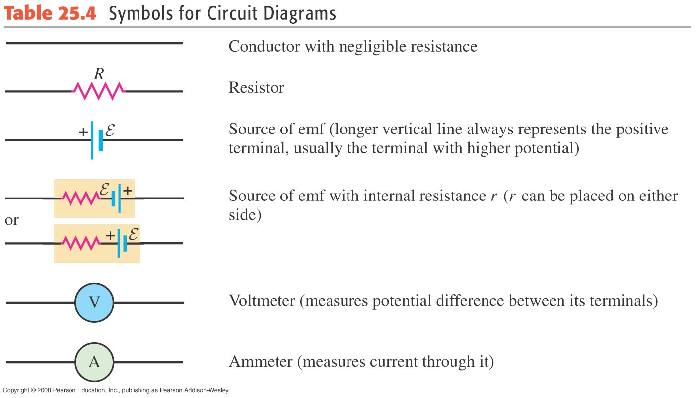
Circuit Elements and Symbols

Slide 21
Activity: Understanding Basic Circuits

Slide 22
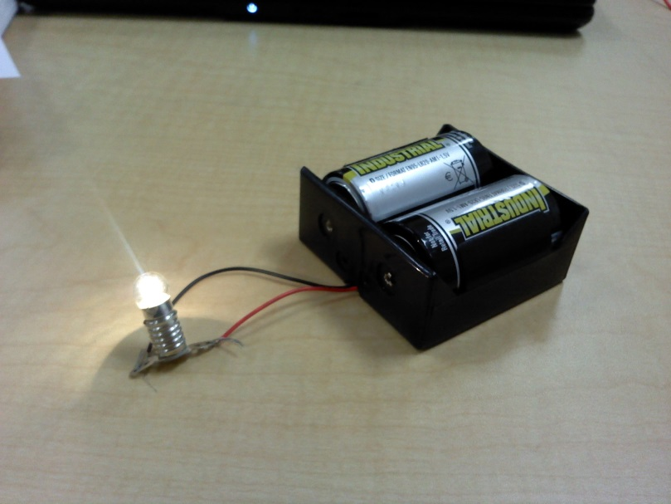

Energy Flow in Circuits
$$P=VI$$

Slide 23
Example: Power in Circuits

Slide 24
Activity: Light Bulbs and Batteries

